Slide 1


STUDIES ON MECHANICAL PROPERTIES OF ADDITIVELY MANUFACTURED STAINLESS STEEL 316L VIA POWDER BED FUSION
By
Project Members
Akash Ben Chris - 211419114023
Aniruddhan V - 211419114033
Batch No: 06
Under the Supervision
Of
Dr. M.Puviyarasan M.E., PhD.,
Professor
Department of Mechanical Engineering,
Panimalar Engineering College.

Slide 2
PRESENTATION OUTLINE
Introduction
Literature review
Research Gap
Objective
Methodology
Experimental Work(The Process)
Results and Discussions
Conclusion
Scope for Future work
References

Slide 3
INTRODUCTION
Additive Manufacturing
Additive manufacturing is the construction of a three-dimensional object from a CAD model or a digital 3D model.
It can be done in a variety of processes in which material is deposited, joined or solidified under computer control, with material being added together typically layer by layer.

Slide 4
INTRODUCTION Cont.
There are seven main categories of Additive Manufacturing processes which are
Material Extrusion
Sheet Lamination
Binder jetting
Material jetting
Vat Photolopymerization
Directed Energy Deposition
Powder Bed Fusion

Slide 5
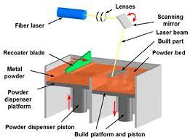
INTRODUCTION Cont.
LASER POWDER BED FUSION:
In this project work, The component fabrication is done by implementing the additive manufacturing technique Laser Powder Bed Fusion
Main source of heat – Laser
LPBF enables manufacturing complex shapes without tooling, castings, or conventional manufacturing methods.
Different types of LPBF techniques are
Selective laser Melting
Direct metal laser sintering

Slide 6
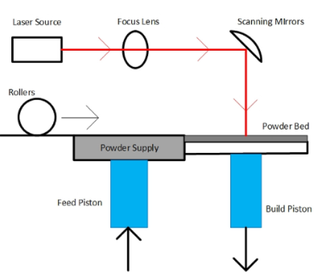
INTRODUCTION Cont.
STEPS INVOLVED IN FABRICATING COMOPONENT VIA L-PBF:
(i)Designing and modelling of the 3D part. Slicing the model in the required number of layers with a defined layer thickness;
(ii) For the fabrication, a substrate is fixed on the build platform. This is the base level upon which layers will be deposited;
(iii) The build chamber is moved into a protective atmosphere, mostly of nitrogen and argon, to minimize the risk of surface oxidation;
(iv) According to the pre-defined layer thickness, the first layer is spread on the build platform;
(v) The laser then scans the powder bed in the pre-defined path to fabricate the layer wise shape as commanded by the CAD software and the model designed;
(vi) Lowering of the building platform and repeating the last two steps of spreading the powder bed and scanning it multiple times until the finished part is produced.

Slide 7
INTRODUCTION Cont.
Merits of Additive Manufacturing:
Create functionally-graded materials — meaning they can have different materials on the inside and outside.
With subtractive manufacturing, some objects are too small or have too awkward an angle to subtract materials in the desired way. Additive manufacturing eliminates that barrier.
Eliminate weight from an object. This is particular important in the aerospace and automobile industries, where weight can affect the functionality of a final product.
Setup costs are mostly eliminated, so creating just a handful of objects becomes more reasonable.
Customizing products, like prosthetics or implants are easier, and could result in better outcomes for patients by using Additive Manufacturing techniques.

Slide 8
INTRODUCTION Cont.
Demerits of Additive Manufacturing:
Additive manufacturing machines are expensive.
Using them to create large lot sizes takes longer than with traditional manufacturing.
Many objects that are additively manufactured require some post-processing to clean and smooth out rough edges, among other things.

Slide 9
INTRODUCTION Cont.
MATERIAL-SS316L
SS316L class is considered as an austenitic type of stainless steel with 2–3% molybdenum substance
This stainless-steel class is especially valuable as applied in acid ecosystems.
Ever since austenitic stainless steel is strong even against temperatures of liquid helium, they are commonly utilized in each cryogenic product.
they are similarly suitable for applications up to 800 ◦C, somewhere they get a broad advantage in boilers, heat exchangers, furnaces, turbines, as well as automotive exhaust techniques, where their ferritic formability or their creep struggle is inadequate.

Slide 10
INTRODUCTION Cont.
PHYSICAL PROPERTIEES OF SS316L
Density | Melting Range | Specific Heat | Magnetic Permeability | Elastic Resistivity
g/commercially made³ | ºF | kJ/kgºK | Oersteds | Microhm-commercially made
7.99 | 2525 | 0.50 | 1.01 | 74

Slide 11
INTRODUCTION Cont.
CHEMICAL COMPOSITION OF SS316L
Element | SS316L
Carbon | 0.021
Manganese | 1.92
Phosphorous | 0.044
Sulphur | 0.030
Silicon | 0..72
Chromium | 17.21
Nickel | 13.21
Molybdenum | 2.22
Nitrogen | 0.09
Iron | balance

Slide 12
LITERATURE REVIEW
Todd M. mower et al. [1] studied the mechanical behaviour of different materials fabricated via Laser powder Bed Fusion. In his findings he has included that almost all of the mechanical properties of the component fabricated via LPBF where superior when compared to the mechanical properties of commercially available SS316L. This conclusion is in line with the conclusion made by Kyu-Tae Kim[14] who investigated the different mechanical performances of austenitic 316L stainless steel fabricated by using AM techniques such as DMLS, SLM and and the SS316L available commercially.
Demirsoz et al.[3] performed a novel use of cryo-MQL system in improving the tribological characteristics of the ss316l. The tribological experiments were conducted on additively manufactured SS316L using a ball-on-flat tribometer under dry, minimum quantity lubrication and at cryogenic conditions. He concluded that the properties of the material were very different in dry environment when compare to cool environment. There are more cracks visible in dry conditions due to the removal of material from the surface which was minimized under lubricated conditions. The tribological properties of additively manufactured SS316L is better when compared to 100Cr6.

Slide 13
LITERATURE REVIEW cont.
Didier Boissekier et al. [6] analysed the influence of powder characteristics in laser direct metal deposition of SS316L for metallic parts manufacturing. He performed his study with different batches of SS316L powders. From this work it can be deduced that, the morphology of the powder affects the flowability and laser/powder interaction. The process parameters cannot be maintained constant for all batched of the powder, it needs to be adjusted for each batch. The absence of porosity in the powder generates macroscopic defects in parts.
Rankouhu et al. [10] studied the functional design which was optimized topologically anf performed fabrication via Directed Energy deposition and Selective Laser Melting and compared their results with FEM. He summarized that typical Fem does not consider many manufacturing- induced anisotropies thereby suggesting that more mesoscale-based models are required to refine the conservative estimates. Moreover in this study it was highlighted that the mechanical properties of SS316L fabricated via SLM are better when compare to the components fabricated via DED and via conventional methods..

Slide 14
LITERATURE REVIEW cont.
Shhrabpoor et al. [8] in his work investigated the microstructural sturdies on the SS316L fabricated via AM techniques and concluded that the the initiation of the defects and cracks in specimen fabricated via AM method is very much less than the commercially available SS316L under the same conditions
Nauman et al. [20] performed cryogenic treatment on SS316L material and investigated the different properties of the matrial under cryogenic conditions and compared it to the properties of stainless steel under normal conditions. The result obtained indicated that under cryogenic conditions there is an increase in the hardness of the material and also there is scope for increase in wear resistance. Wang et al. [21] manufactured the SS316L specimen via laser powder bed fusion and investigated on the crystallographic orientation dependence on the charpy impact behaviour of the specimen under room temperature and liquid nitrogen temperature. He concluded that the sample oriented in three different planes exhibited similar toughness at room temperature. The absorbed energy of these samples regardless of their orientation decreased about 30 to 40% under liquid nitrogen temperature.
.

Slide 15
LITERATURE REVIEW cont.
Sathies et al. [22] explored the changes happening in the mechanical and microstructural characteristics of additively manufactured SS316L components post heat treatment. From this work it can be deduced that heat treatment can be adapted to alter the mechanical characteristics of additively manufactured SS316L components and the heat treatment also increases the ductility of the sample thereby lowering its toughness

Slide 16
SUMMARY OF LITERATURE SURVEY
Additive manufacture technique is very efficient to build components with very intricate patterns and complex shapes.
SS316L is suitable candidate to print components by using any one of the AM methods.
The powder characteristics plays a major role on the mechanical and morphological properties of the component being built. It is also responsible for the defects arising on the component.
The process parameters implemented during the component building influences the various properties of the final built component.

Slide 17
SUMMARY OF LITERATURE SURVEY
Additive Manufacturing method can be utilized to produce components with better mechanical properties such as tensile strength, ductility, wear properties, hardness etc., .
Heat treatment process can implemented to enhance the properties of components fabricated via AM techniques.
The build orientation, the build angle and the build direction plays a major role on determining the strength of the component being built.
In general the properties of the component built via SLM is better than the properties of the component built via DED or via conventional methods.

Slide 18
Research Gap
There are several journals and reports available providing the data and findings on different mechanical properties such as tensile strength, Fatigue strength, wear properties, hardness, etc., of SS316L.
The above mentioned mechanical properties of SS316L are also measured and recorded when the material is subjected to any heat treatment.
Although several works are being reported on SS316L which is fabricated by using AM technique, the impact studies on the component is rarely performed and moreover the impact studies under sub-zero conditions are very few.

Slide 19
Objectives
To fabricate a component made from the powder particles of SS316L component by using Selective Laser Melting technique.
To perform tensile testing on the components.
To perform the impact testing under sub-zero conditions with temperatures ranging between 0 to -50 ºC.
To study the microstructures of the component by performing optical microscopy.
To compare the results with commercially available SS316L

Slide 20
Methodology
LPBF SS316L
COMMERCIAL SS316L
TENSILE TEST
IMPACT TEST (SUB-ZREO)
OPTICAL MICROSCOPIC ANALYSIS
RESULTS
CONCLUSION

Slide 21
Experimental Work (The Process)
FABRICATION OF SS316L VIA PBF
Initially a powder bed is spread, and pre-determined regions are exposed to high-intensity laser energy.
That way, powders can be melted and fused layer-by-layer in compliance with the design prepared in the CAD software.
After completion of the first layer the build platform is lowered and the next layer of powder particles are exposed to laser. The steps are repeated until the final component is obtained.

Slide 22
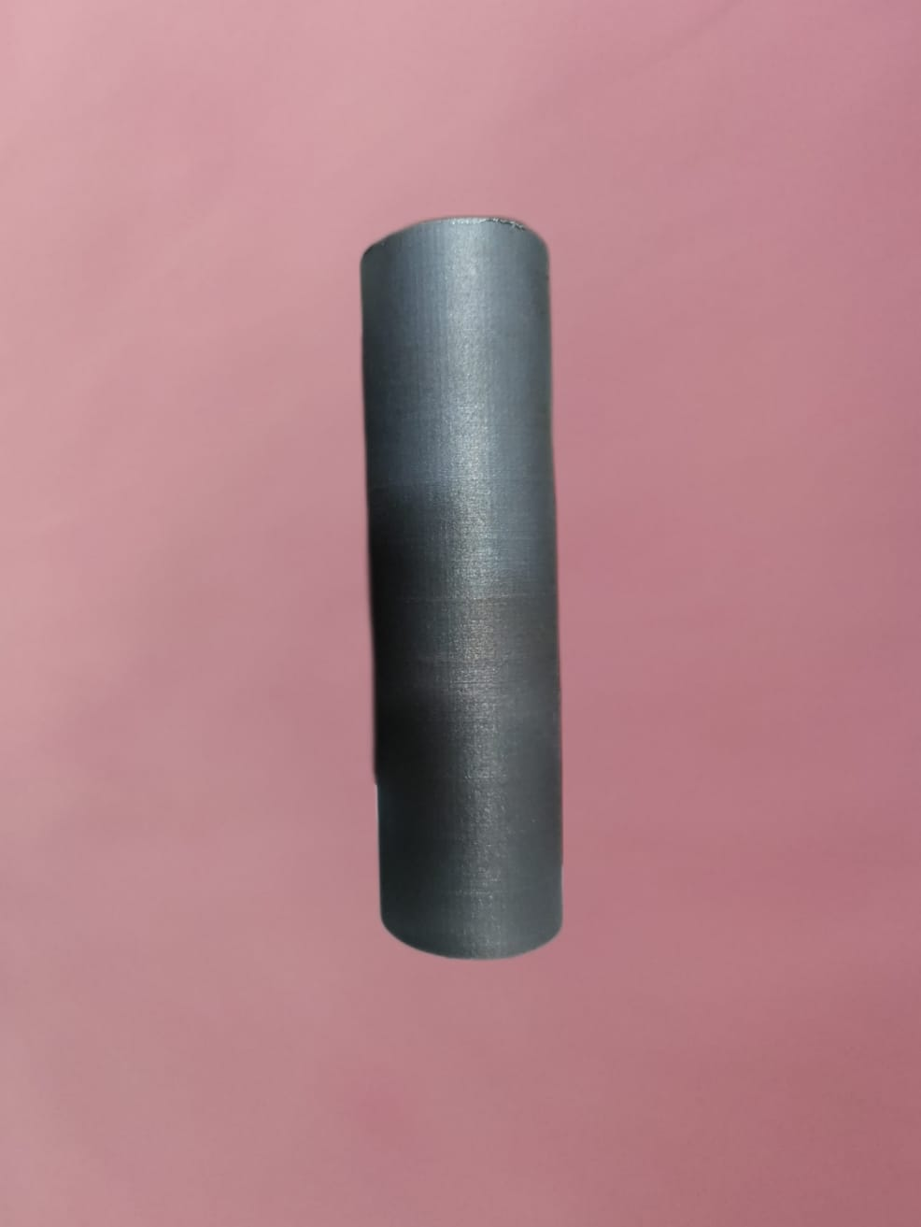
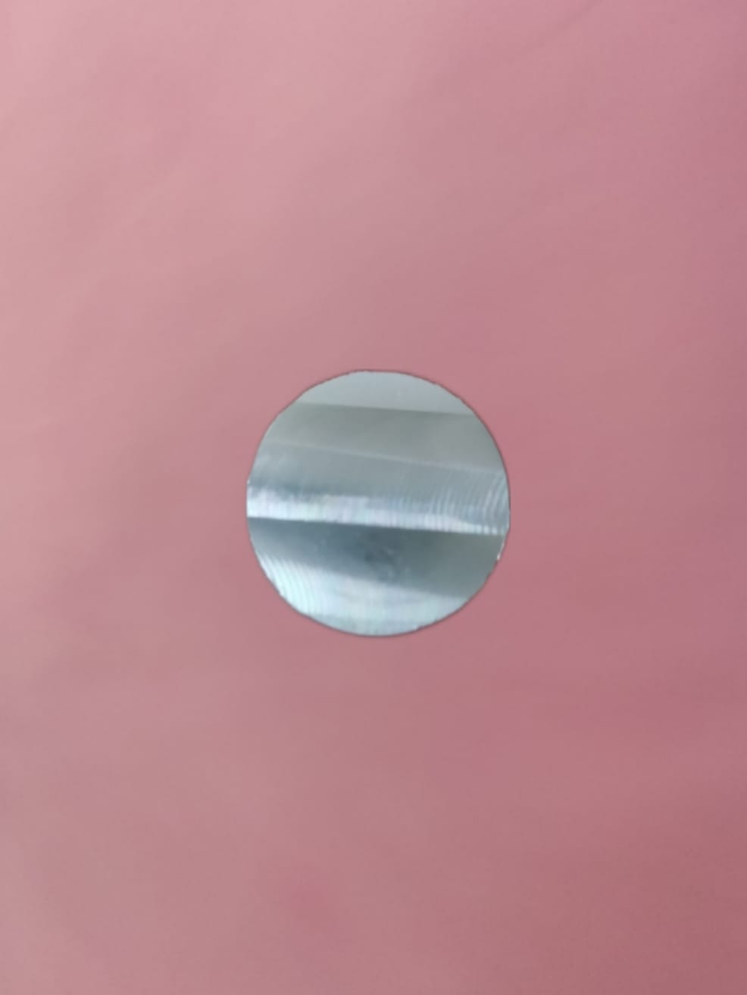
Experimental Work (The Process)
Process parameters:
Laser power - 295 W
Inert gas - Argon
Scanning Strategy - 67 deg angle scan
Scanning speed - 800 mm/s
Layer thickness 60 micron
Hatch distance - 120 micron
Yb-fiber laser
laser spot diameter - 100 micron
100mm
30mm

Slide 23
Experimental Work (Testing) Cont.
Tensile Testing
This test method is used to determine yield strength, ultimate tensile strength, ductility, strain hardening characteristics, Young’s modulus and Poisson’s ratio.
Tensile test dog-bone specimens of 20 mm gauge length and narrow section diameter of 5 mm of tensile tests according to ASTM E8 was machined.
The results of PBF SS316L specimen and Conventionally made specimens were compared.

Slide 24
Experimental Work (Testing) Cont.
Charpy Impact Testing
The Charpy V-notch test, is a standardized high strain-rate test which determines the amount of energy absorbed by a material during fracture
The V-notch rod specimen cut-off had the dimensions 10 mm x 10 mm x 55 mm which were prepared as per the ASTM E23-72 standard.
The Impact test on the samples were carried under room temperature and under sub-zero conditions. To perform the impact test under sub-zero conditions, the specimens were immersed in dry ice until the required temperatures are achieved.

Slide 25
Experimental Work (Testing) Cont.
Optical Microscopic Analysis
For microscopic analysis, the sample of size 10 x 10x 4 mm³ were cut using Wire Cut Electric Discharge Machine (WEDM).
The specimens were prepared as per ASTM E3 standard and necessary enchant was used.

Slide 26
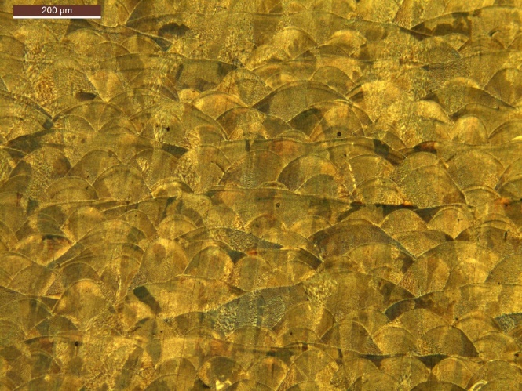
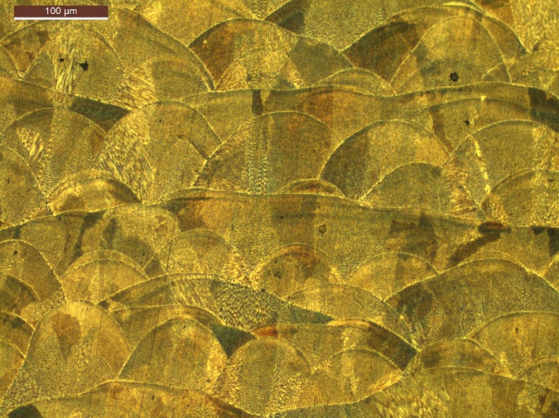
Results and Discussion – Microstructure LPBF SS316L
The images of PBF SS316L shows segregated melt pools with discrete boundaries, a few small voids and a fine crystalline microstructure.
The grains were not confined to their first deposited layers during solidification and growth, and they grew epiaxially beyond several layers to obtain their coarse and elongated appearance.

Slide 27
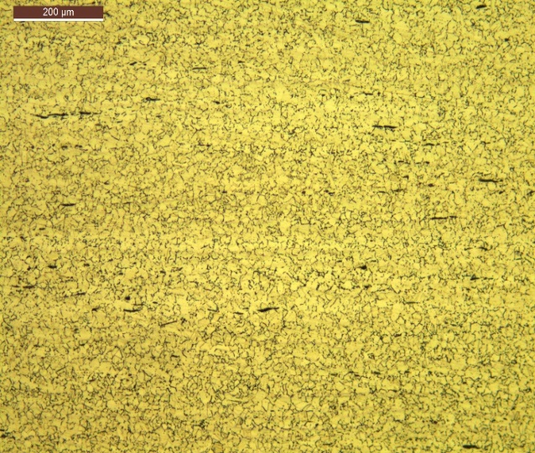
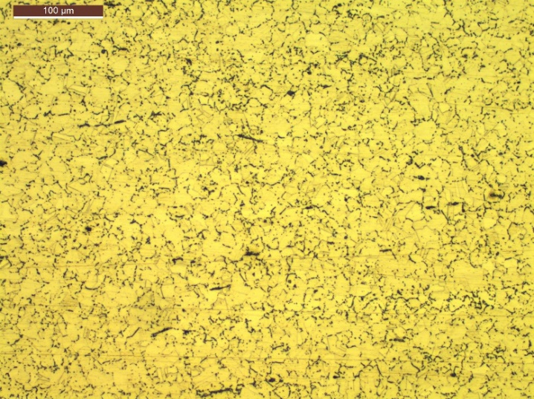
Results and Discussion – Microstructure Conventionally made SS316L
The grain boundaries are clearly indicated N
o defects such as pores or pits are visible

Slide 28
Results and Discussion – Tensile Test
Specimens | Yield Strength (MPa) | Ultimate tensile strength (MPa) | Fracture elongation (%)
PBF-Horizontal | 530 | 640 | 40
PBF-Vertical | 470 | 540 | 50
Commercial | 170 | 485 | 30
Tensile properties of PBF SS316L specimens are good compared to Conventionally fabricated SS3316L specimen
The tensile properties of PBF SS316L sample is better when it is fabricated in the horizontal direction than in vertical direction which is due to the stair stepping effect of additive manufacturing.

Slide 29
Results and Discussion- Impact at sub-zero survey
It is evident from the graph that the impact energy slightly decreases in PBF SS316L when compared to conventionally fabricated SS316L as the temperature decreases and at -50º C, the PBF SS316L impact energy absorbed very much less compared to conventionally fabricated SS316L.
It can be concluded that under Sub-zero condition PBF SS316L slightly less tougher than conventionally made SS316L.
-

Slide 30
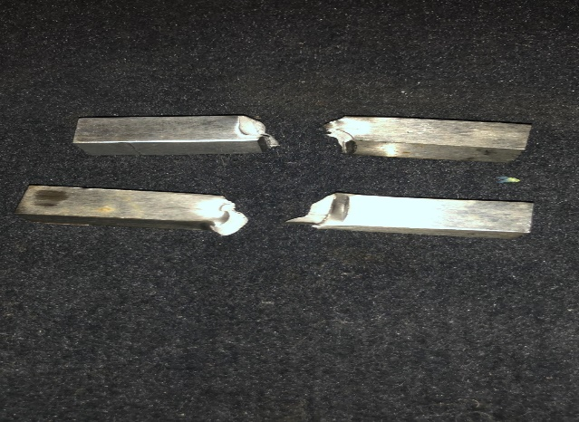
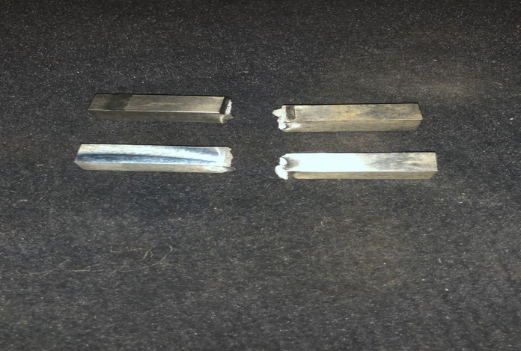
Results and Discussion – Sub-Zero Impact test
Specimens after sub-zero impact testing.

Slide 31
Conclusion
The microsccopic images of PBF SS316L shows segregated melt pools with discrete boundaries, a few small voids and a fine crystalline microstructure.
The microstructures of the PBF manufactured SS316L and conventionally machined SS316L does not match.
Tensile properties of the SS316L fabricated via PBF is higher when compare to the tensile properties exhibited by conventionally fabricated SS316L. In PBF SS316L the maximum ultimate tensile strength was observed to be 640MPa with an elongation of 40%.
The tensile properties of PBF SS316L is very good in the horizontal direction than in the vertical direction which is due to the stair stepping effect of the additive manufacturing being exhibited.

Slide 32
Conclusion
Under sub-zero conditions, the impact energy absorbed by PBF SS316l is less compared to the impact energy absorbed by conventionally fabricated SS316L which indicates that the latter is much tough as the temperature decreases and the PBF SS316L transforms from ductile to brittle under sub-zero conditions before conventionally machined SS316L.
The mechanical properties of PBF SS316L are good under room temperature when compared to that of conventional made SS316L and under sub-zero conditions, The additively manufactured components matches exhibits mechanical properties which are does not deviates much from the properties of conventionally made SS316L in sub-zero conditions and the results obtained confirms that.
Under sub-zero conditions, there is a 91% match in the mechanical properties of PBF SS316L to that of conventionally made SS316L.

Slide 33
Conclusion- Key Takeaways
Components of SS316L fabricated via PBF exhibit good tensile properties and can be utilized in applications where high strength and ductility is required.
The impact energy absorbed by PBF SS316L are within the acceptable range, to be used under sub-zero conditions in applications such as aerospace industries etc.,
Under Sub-zero conditions almost all the properties of the PBF SS316L are maintained.
The impact properties of PBF SS316L are slightly less when compared to conventionally fabricated SS316L under sub-zero conditions.

Slide 34
References
[1] Todd M. Mower, Michael J. Long, “Mechanical behavior of additive manufactured, powder-bed laser-fused materials” Materials Science and Engineering A, 2016.
[2] Abhi Ghosh , Sanchari Biswas , Tiffany Turner , Anne-Marie Kietzig , Mathieu Brochu “Surface, microstructure, and tensile deformation characterization ofLPBF SS316L microstruts micromachined with femtosecond laser” , Material and Design, 2021.
[3] Recep Demirs¨oz , Mehmet Erdi Korkmaz , Munish Kumar Gupta
“A novel use of hybrid Cryo-MQL system in improving the tribological characteristics of additively manufactured 316 stainless steel against 100 Cr6 alloy”, Tribology International, 2022.
[4] Won-Sang Shin , Bongkuk Son , Wansu Song d, Hyonkee Sohn , Ho Jang , Yoon-Jun Kim , Changkyoo Park , “ Heat treatment effect on the microstructure, mechanical properties, and wear behaviors of stainless steel 316L prepared via selective laser melting”, Materials Science and Engineering A, 2021.
[5] Cheng-Han Yu, lexander Leicht, Ru Lin Peng, Johan Moverare “Low cycle fatigue of additively manufactured thin-walled stainlesssteel 316L” Material Science and Engineering, 2021.

Slide 35
References Cont.
[6] Didier Boisselier , Simon Sankaré , “Influence of powder characteristics in laser direct metal deposition of SS316L for metallic parts manufacturing”, Physics Procedia, 2012.
[7] Umar Hossain, Shaaz Ghouse , Kenneth Nai , Jonathan R.T. Jeffers, “Mechanical and morphological properties of additively manufactured SS316L and Ti6Al4V micro-struts as a function of build angle”, Additive Manufacturing, 2021.
[8] H. Sohrabpoor , V. Salarvand , R. Lupoi , Q. Chu , W. Li , B. Aldwell , W. Stanley , S. O’Halloran , R. Raghavendra , C.-H. Choi , D. Brabazon, “ Microstructural and mechanical evaluation of post-processed SS 316L manufactured by laser-based powder bed fusion”, Journal of Materials Research and Technology, 2021.
[9] Jingjing Niea, Liang Weib, Dong-ling Lic, Lei Zhaoc, Ying Jianga, Qian Lia, “High-throughput characterization of microstructure and corrosion behavior of additively manufactured SS316L-SS431 graded material”, Additive Manufacturing, 2020.

Slide 36
References Cont.
[10] B. Rankouhi , K.M. Bertsch , G. Meric de Bellefon , M. Thevamaran , D.J. Thoma , K. Suresh , “Experimental validation and microstructure characterization of topology optimized, additively manufactured SS316L components”, Material Science and Engineering A, 2020.
[11] Sajid Alvi , Kamran Saeidi , Farid Akhtar, “High temperature tribology and wear of selective laser melted (SLM) 316L stainless steel”,Wear, 2020.
[12] S.Choudhary , V. Cruz , A. Pandey , S. Thomas , N. Birbilis , “Element-resolved electrochemical analysis of the passivity of additively manufactured stainless steel 316L”,Corrosion Science, 2021.
[13]Kartikeya Sarma , V. Srinivas , S. Kanmani Subbu, “Comparison of wear and corrosion resistance behaviour of LENS deposited SS 316L alloy and wrought alloy”, Materials Today: Proceedings , 2020.
[14] Kyu-Tae Kim, “Mechanical performance of additively manufactured austenitic 316L stainless steel”, Nuclear Engineering and Technology, 2021.

Slide 37
References Cont.
[15] M. Kumaran , V. Senthilkumar , C.T. Justus Panicke , R. Shishir , “Investigating the residual stress in additive manufacturing of repair work by directed energy deposition process on SS316L hot rolled steel Substrate”, Materials Today: proceedings, 2021.
[16] Hua Lia, Maziar Ramezania, Ming Lib, Chao Mab, Jyhwen Wang, “Tribological performance of selective laser melted 316L stainless steel”, Tribology International, 2018.
[17] Ram Krishna Upadhyay, Arvind Kumar, “Scratch and wear resistance of additive manufactured 316L stainless steel sample fabricated by laser powder bed fusion technique”, Wear, 2020.
[18] Xue Wanga, Liping Zhao, Jerry Ying Hsi Fuh, Heow Pueh Lee,
“Experimental characterization and micromechanical-statistical modeling of 316L stainless steel processed by selective laser melting”, Computational Materials Sciences, 2020.
[19] Y. Yanga, Y. Zhua, M.M. Khonsaric, H. Yanga, “Wear anisotropy of selective laser melted 316L stainless steel”, Wear, 2020.

Slide 38
References Cont.
[20] Mohd Touseef Nauman, S. Rasool Mohideen, Nasreen Kaleem, “Materia Characterization of 316L Stainless Steel After Being Subjected To Cryogenic Treatment”, International journal Of Mechanical And Industrial Engineering, 2013.
[21] Xianglong Wang, Oscar Sanchez-Mata, Sula Ecw Atabay, Jose Alberto Muniz-Lerma, Mohammad Attarain Shandiz, Mathieu Brochu, “Crystallograpic orientation dependence of Charpy Impact Behaviours in Stainless Steel 316l Fabricated By Laser Powder Bed Fusion”, Additive Manufacturing, 2021.
[22] T. Sathies, M. Kumaran, G. Bharathiraja, N.S Balaji, T.G. Unnikrishnan, V. Senthil Kumar, “ Investigations on the Effect of Heat Treatment on Laser Poeder Bed Fusion Built SS326L alloy.

Slide 39
Thank You

